Slide 1
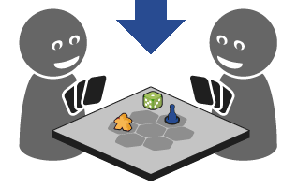
Bounded Suboptimal N-Player Game Tree Search
Advisor: Dor Atzmon
Asi Zaks, Shachar Meretz, Omer Nagar, Peleg Biton

Slide 2
Minimax
MAX player
MIN player
Fundamental decision-making rule in zero-sum games (Wald 1945)
A player chooses an action that maximizes its utility
Assuming the other player will choose the action that will minimize its utility
6
6
4
6
7
5
4
Notes:
Talk about 2-Player

Slide 3


Bounded Alpha-Beta - Theorem
For a game tree $G$, an algorithm $A$, and any $ε≥0$, if all the conditions hold,
then $$L\left(n\right)≤Minimax\left(n\right)≤U\left(n\right)$$
$$U\left(n\right)−L\left(n\right)≤ε$$

Slide 4


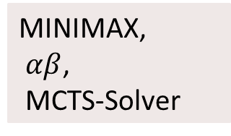
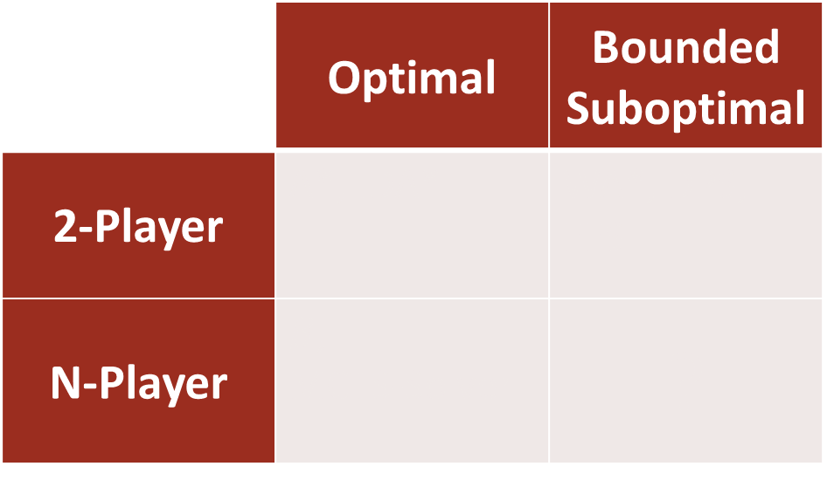
Intro
 | Optimal | Bounded Suboptimal
2-Player | A*, IDA* | WA*, DPS, EES
N-Player | $β$, MCTS-Solver | ?
MINIMAX,
$αβ$,
MCTS-Solver
Bounded $αβ$
MaxN, Paranoid, BRS
?

Slide 5

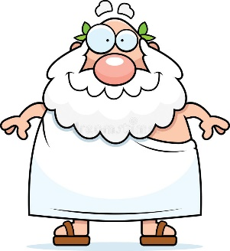
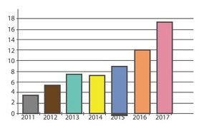
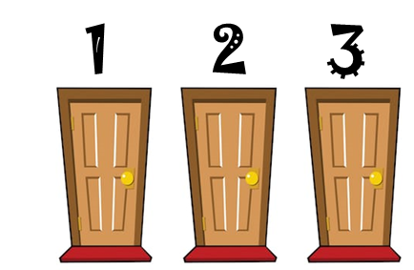



Motivation
Game Theory
Philosophy
Statistics
Decision Theory
Economics
Robotics
Security

Slide 6
Previous Work
Defined optimal solutions for 2-Player & N-Player games.
Shown how and in which conditions optimal solutions for 2-Player & N-Player games can be achieved.
Shown how and in which conditions bounded suboptimal solutions for 2-Player games can be achieved.
Our Goal:
Show how and in which conditions
bounded suboptimal solutions for N-Player games
can be achieved.

Slide 7
Our Research
Steps to accomplish -
Understand better what considered optimal solutions
for N-Player games & bounded suboptimal solutions for 2-Player games.
Define and prove what considered as a suboptimal solution for N-Player game.
Define pseudo algorithms for bounded suboptimal solutions based on known optimal solutions.
Implement those algorithms for chosen games.
Perform experiments and analyze their results.

Slide 8
Thanks!

